Slide 1

Beyond the Cure: Modeling the Risk of Breast Cancer Recurrence
Brandon Thomas

Slide 2
Purpose/ Research Question
Purpose
Create a model that allows clinicians to create a personalized treatment plan
Improve patient outcomes and enhance survivorship
Research Question(s)
What variables are most important in predicting breast cancer recurrence?
Can breast cancer be accurately predicted (relative) with the variables included in my dataset?

Slide 3
Data Description
Name | Data Type | Possible Values | Percent Missing Data (% of 286)
Class | Nominal | No-recurrence-events, recurrence-events | 0
Age | Ordinal | 10-19, 20-29, 30-39, 40-49, 50-59, 60-69, 70-79, 80-89, 90-99 | 0
Menopause | Nominal | lt40, ge40, premeno | 0
Tumor Size | Ordinal | 0-4, 5-9, 10-14, 15-19, 20-24, 25-29, 30-34, 35-39, 40-44, 45-49, 50-54, 55-59 | 0
Inv-Nodes | Ordinal | 0-2, 3-5, 6-8, 9-11, 12-14, 15-17, 18-20, 21-23, 24-26, 27-29, 30-32, 33-35, 36-39 | 0
Node-Caps | Nominal | Yes, no | 2.7972
Deg-Malig | Ordinal | 1, 2, 3 | 0
Breast | Nominal | Left, Right | 0
Breast-Quad | Nominal | left-up, left-low, right-up, right-low, central | 0.3497
Irradiat | Nominal | Yes, No | 0

Slide 4
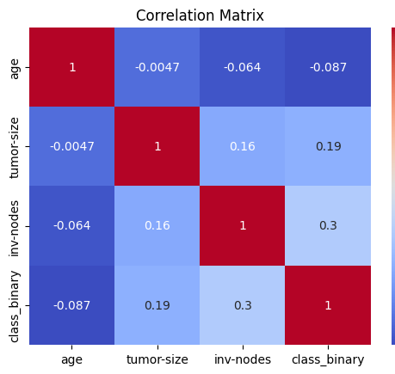
Correlation Matrix
‘invasive nodes’ have a moderate positive correlation with ‘class_binary’ (0.3), implying that a greater number of invasive nodes is somewhat linked to a positive classification
‘Tumor size’ exhibits a weak positive correlation with ‘invasive nodes’ (0.16) and ‘class_binary’ (0.19), suggesting that larger tumors may be slightly associated with a higher likelihood of positive classification and more invasive nodes

Slide 5
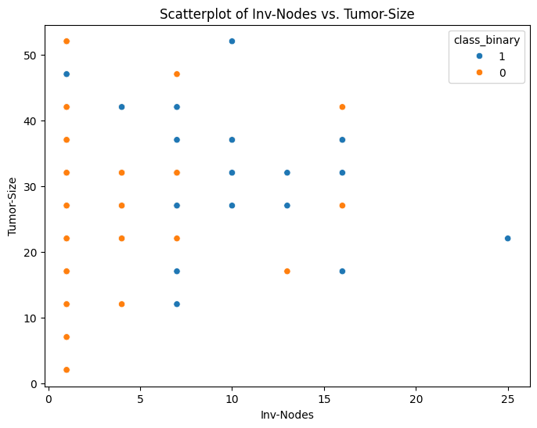
Scatterplot
Slight positive relationship between ‘tumor-size’ and ‘invasive-nodes,’ more so for recurrent cancer cases
Generally as tumor size increases, so does invasive nodes

Slide 6
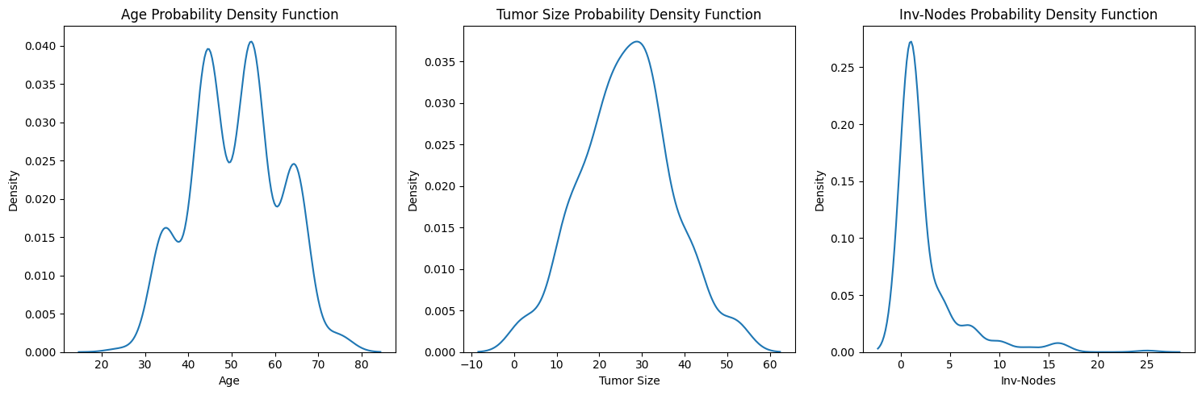
Probability Density Functions

Slide 7
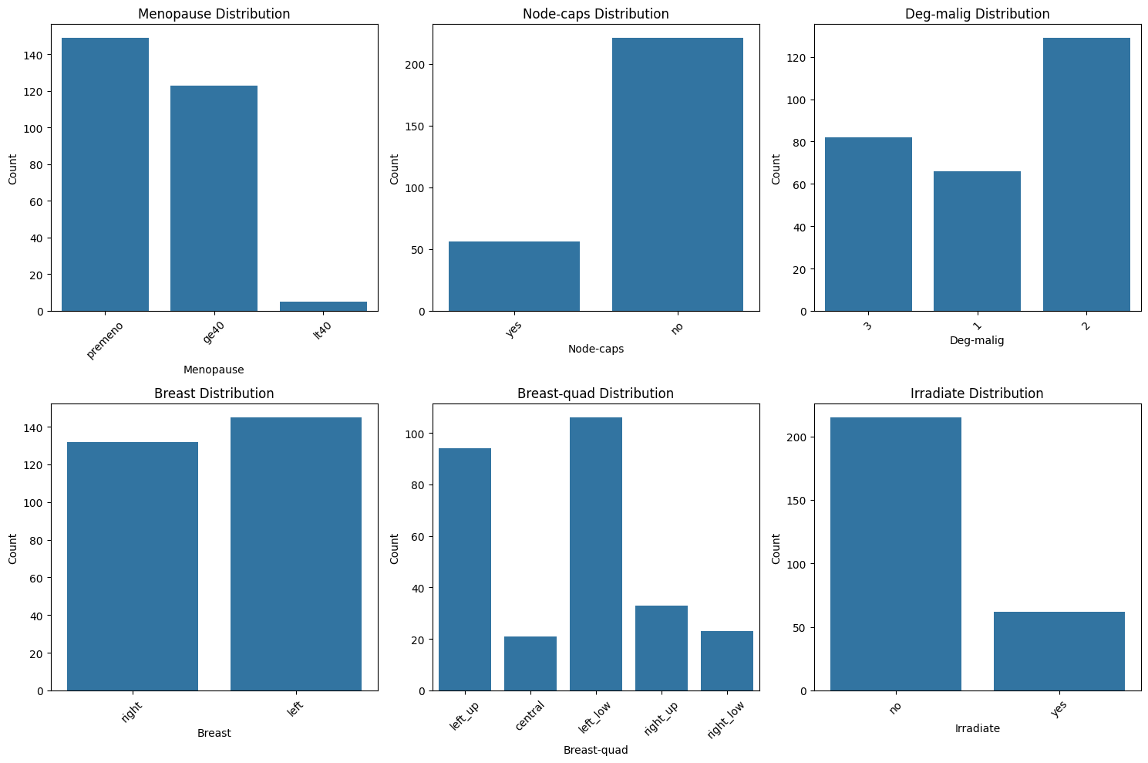
Bar Charts

Slide 8
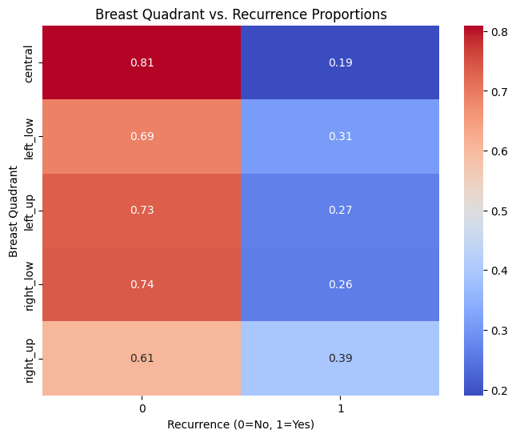
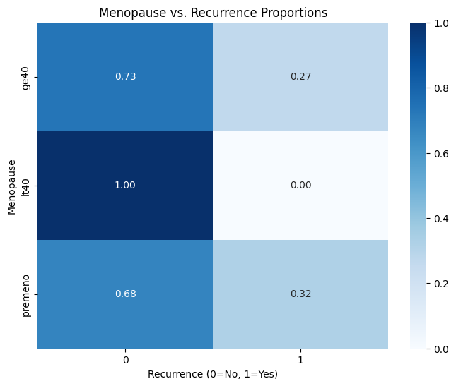
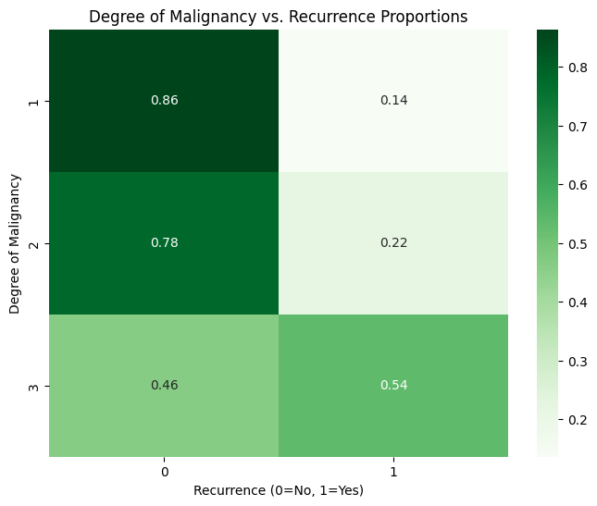
Heat maps

Slide 9
Summary
Key Findings
No cancer recurrence in patients with menopause before age 40
Higher recurrence rates in:
Left breast cancer
Right upper tumor localization
Patients receiving radiation
Future Considerations
Imbalance in qualitative variables but should be sufficient for some machine learning models

Slide 10
References
Blows, F. M., Driver, K. E., Schmidt, M. K., et al. (2010). Subtyping of breast cancer by immunohistochemistry to investigate a relationship between subtype and short and long term survival: a collaborative analysis of data for 10,159 cases from 12 studies. PLoS medicine, 7(5), e1000279.
Early Breast Cancer Trialists' Collaborative Group (EBCTCG). (2021). Long-term outcomes after radiotherapy or surgery for early-stage breast cancer. The Lancet Oncology.
Gao, Z., Zhang, Y., Styblo, T. M., et al. (2022). Machine learning applications in predicting breast cancer recurrence and treatment response. Cancer Informatics, 21, 117693512211073.
Lichman, M.: UCI machine learning repository, University of California, School of Information and Computer Science, Irvine, CA (2019). http://archive.ics.uci.edu/ml/datasets/breast+cancer
Yasaka, K., Akai, H., Kunimatsu, A., et al. (2018). Deep learning with convolutional neural network for differentiation of liver masses at dynamic contrast- enhanced CT: a preliminary study. Radiology, 286(3), 887-896.
Zhang, X., Yang, P., & Xu, Z. (2020). Applications of machine learning in breast cancer diagnosis and prognosis. Cancer Biology & Medicine, 17(4), 943.

